Slide 1
Evaluator of HIV-RT Personnel Competency:
Competency Assessment Overview

Slide 2

Learning Objectives
  Describe the components of a HIV-RT tester personnel competency assessment.
  Describe the overall structure & format of a HIV-RT personnel competency assessment.

Slide 3
Competency Assessment Components
Competency Assessment | Introduction Evaluator and topic/purpose introduced
 | Direct Observation Checklist Appropriate checklist used, minimum assistance/guidance/interruption
 | Feedback Summary, assessment conclusions

Slide 4
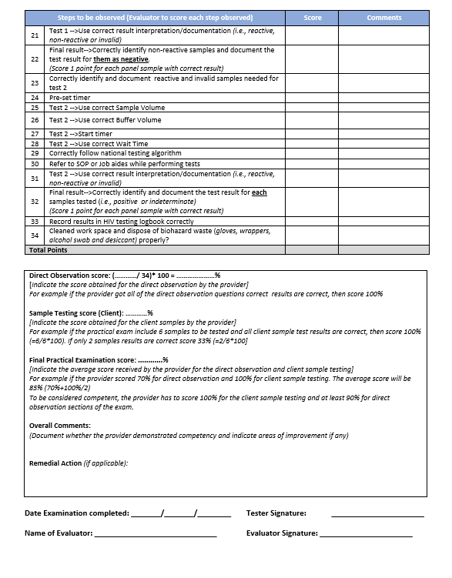

Slide 5
Tester Competency Assessment Components
Structure & Format | Overall Organization Preparedness, use of time, focus on objectives/task
Notes:
Points to mention:
Written and practical exam
Don’t want to interrupt services of facility

Slide 6
Summary
  What are the components of a HIV-RT personnel competency assessment?
  What is the overall structure & format of a HIV-RT personnel competency assessment?

